Slide 1
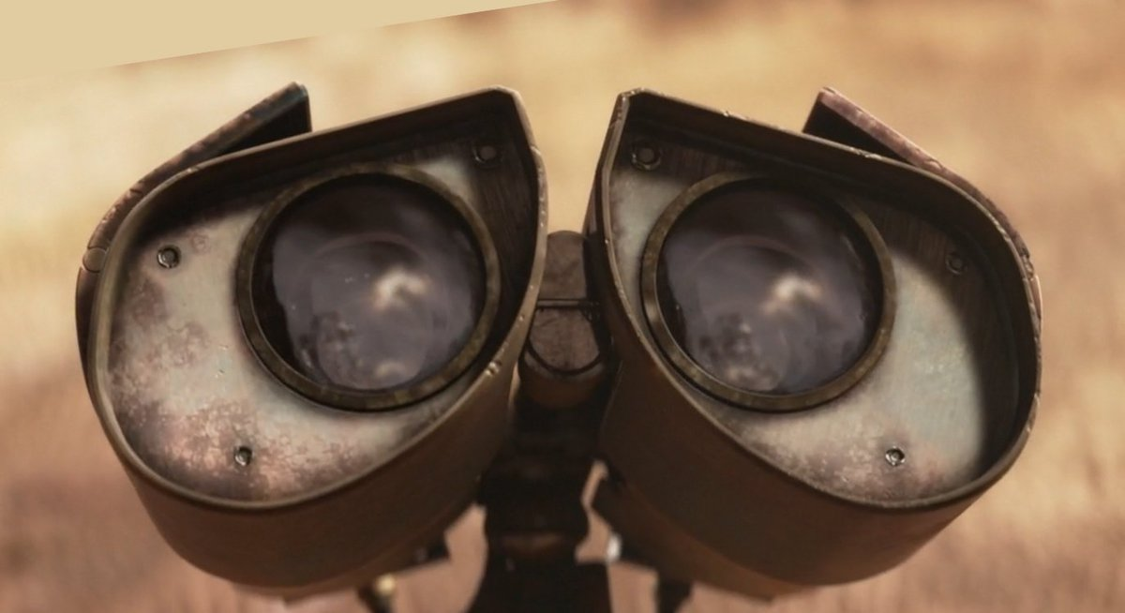
AI-ML: A FIRST YEAR’S PERSPECTIVE
Adithya Venkateswaran Subrahmanya V Bhide

Slide 2
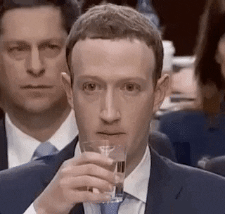

Slide 3
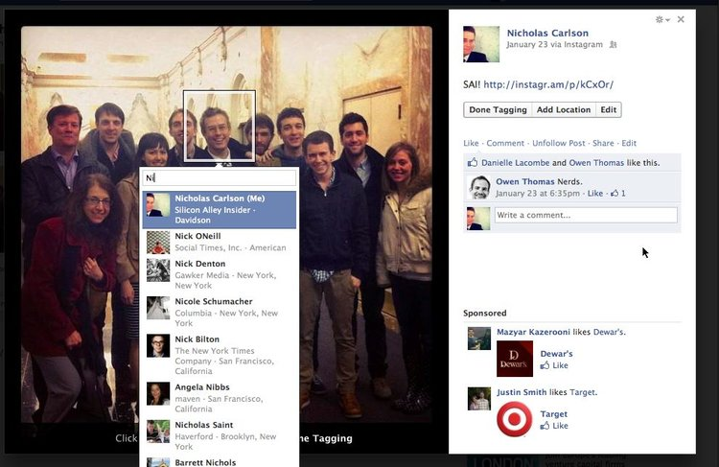
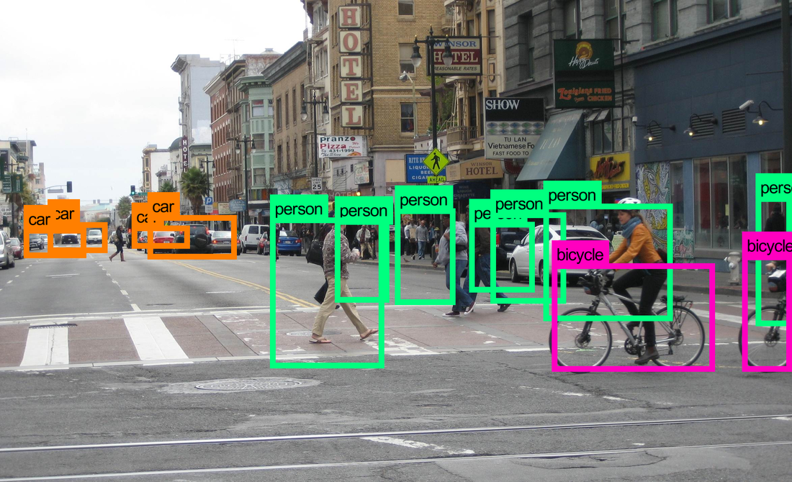
What is Computer Vision??

Slide 4
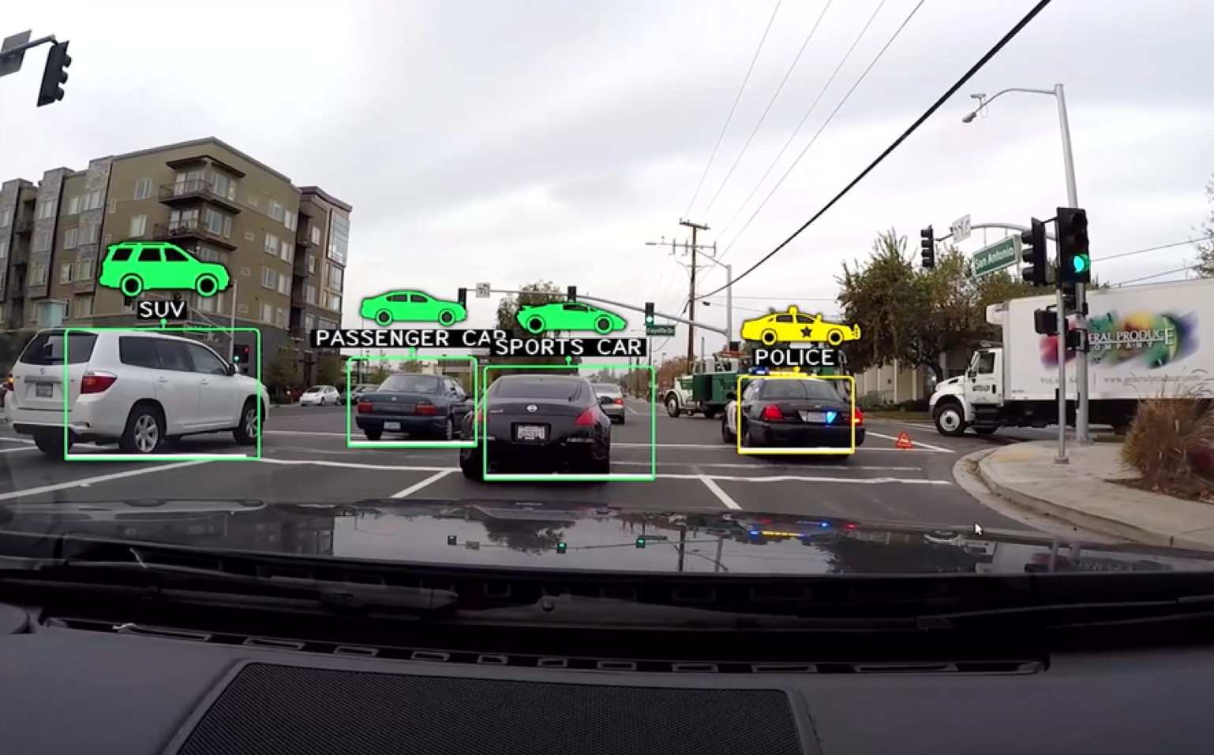

Slide 5
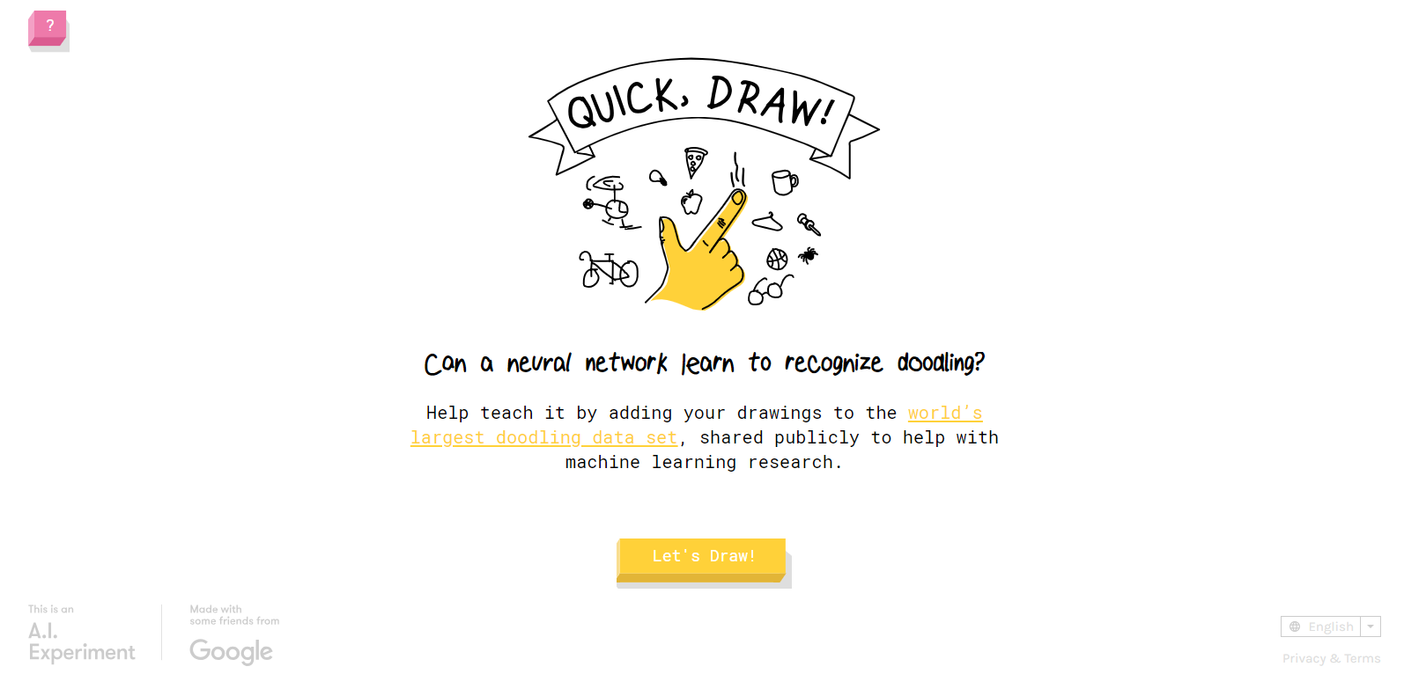
https://quickdraw.withgoogle.com/

Slide 6
HOW WE DID IT!!
With love of course ;)

Slide 7





Slide 8
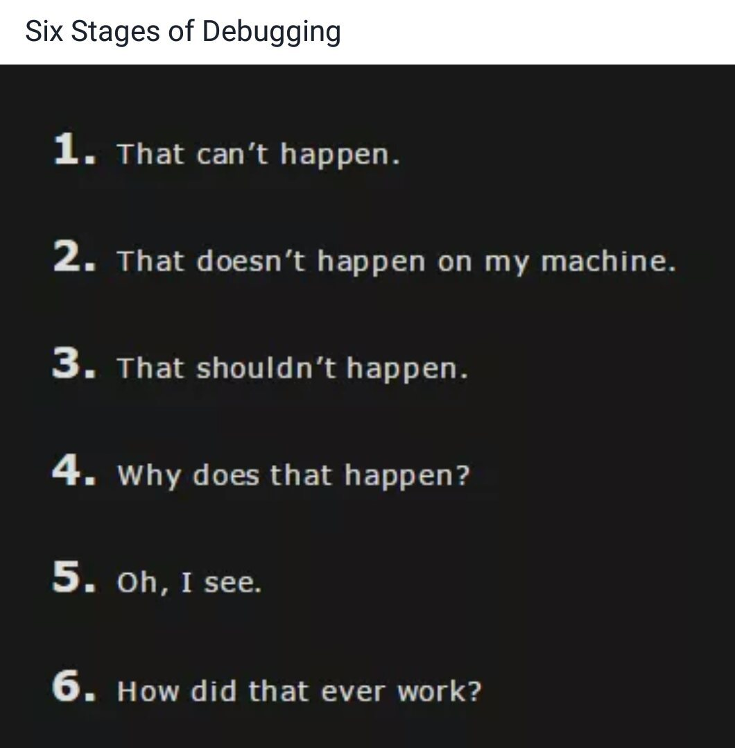
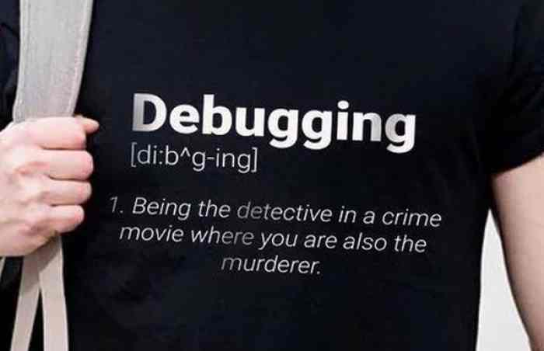
WHAT WE LEARNT…

Slide 9
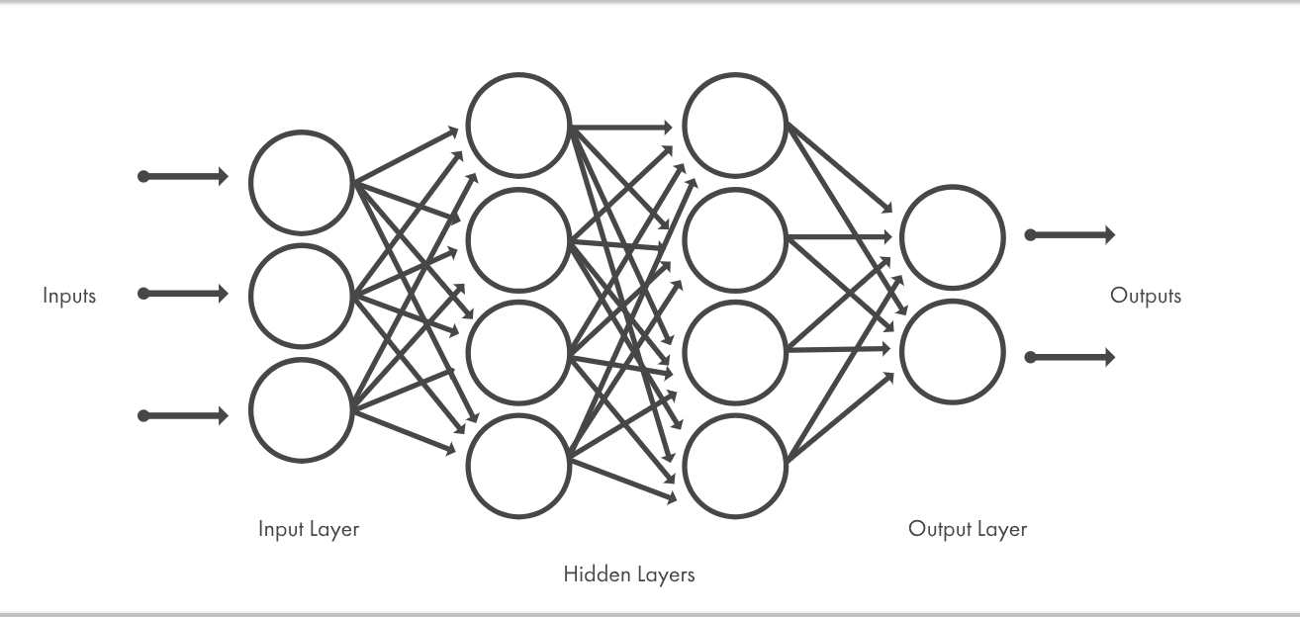

Slide 10
TIMELINE COMPUTER VISION
IRIS
MNIST
FACE RECOGNITION
FACE CLASSIFICATION
OBJECT CLASSIFICATION

Slide 11
WHAT ARE FILTERS?

Slide 12
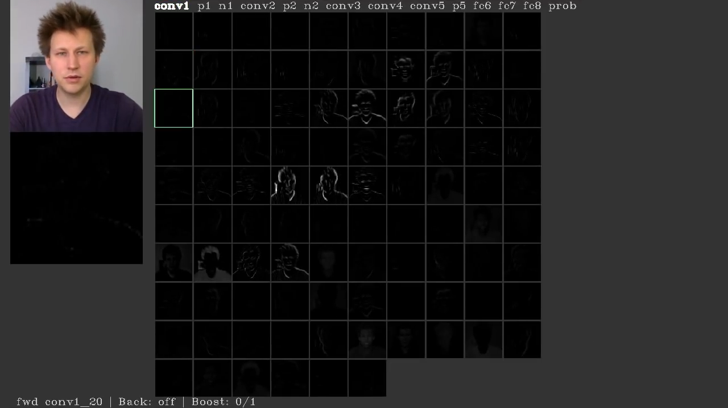

Slide 13
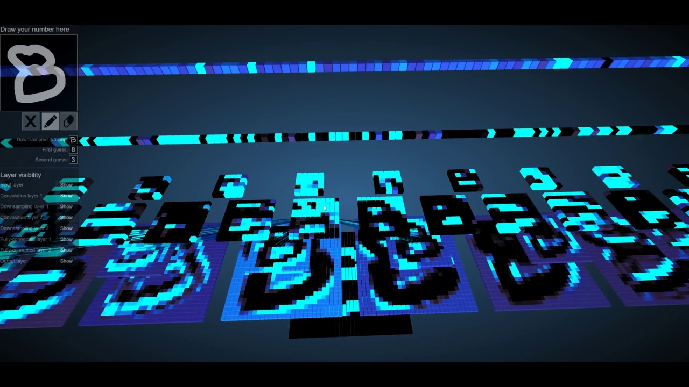

Slide 14
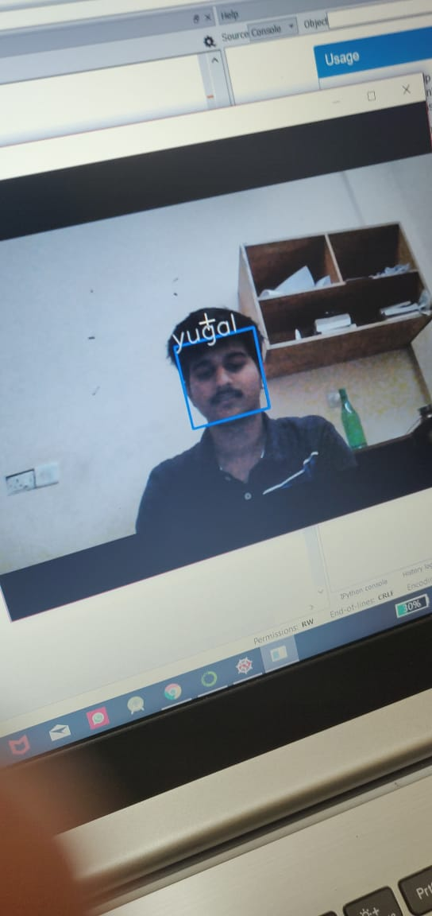
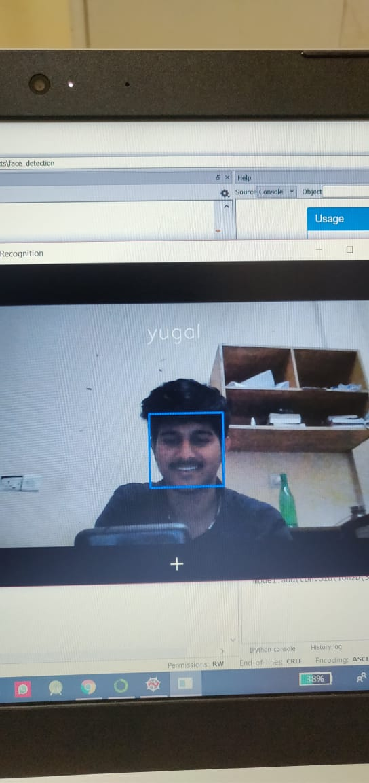

Slide 15
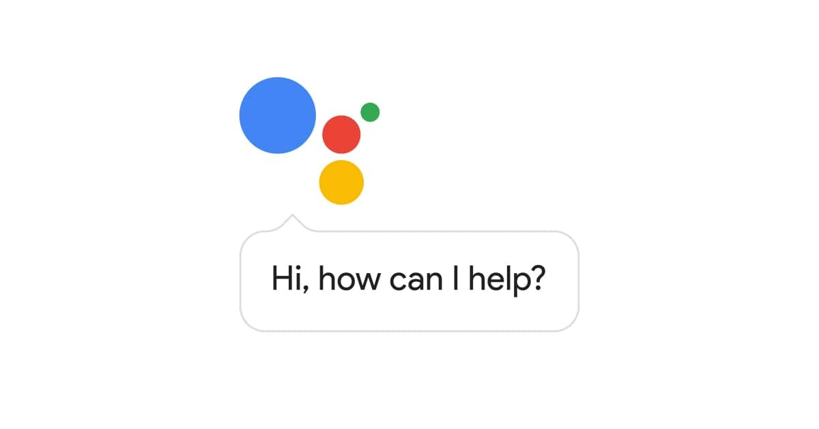


NATURAL LANGUAGE PROCESSING
This includes
Text Analysis
Speech Analysis
Chatbots ....

Slide 16
TIMELINE NLP
IRIS
NAIVE BAYES
SPECTROGRAM GENERATOR
SPEECH ANALYSIS
DIGIT CLASSIFIER

Slide 17
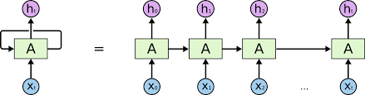
RNNs

Slide 18
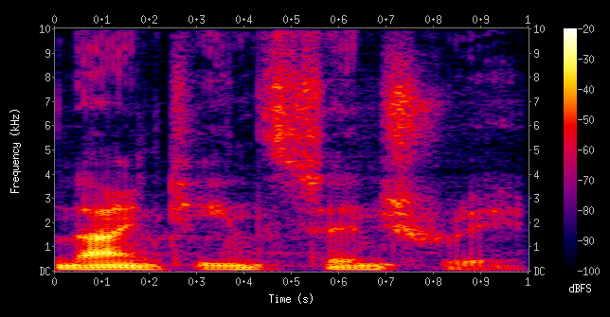
SPECTROGRAM

Slide 19
DIGIT CLASSIFIER

Slide 20
THE EXPERIENCE

